Slide 1
Topics
The Risk-Return Tradeoff: Capital Asset Pricing Model (CAPM)
Security Market Line (SML)
Risk-Adjusted Performance
Market Model for Performance Analysis
Market-Neutral Portfolio
Key Takeaways

Slide 2

CAPM
$E\left[r_{i}\right]=r_{f}+β_{i}\underset{market risk premium}{\underbrace{\left(E\left[r_{m} \right] −r_{f}\right)}}$
$E\left[r_{i}\right]$ : Expected return for Stock $i$
$E\left[r_{m}\right]$ : Expected return for the market
$r_{f}$ : risk-free rate
$E\left[r_{i}\right]−r_{f}=β_{i}\underset{market risk premium}{\underbrace{\left(E\left[r_{m} \right] −r_{f}\right)}}$
$β_{i}=\frac{Cov\left(r_{i}−r_{f},r_{m}−r_{f}\right)}{σ_{m}^{2}}$; $σ_{m}^{2}$: variance of market returns

Slide 3
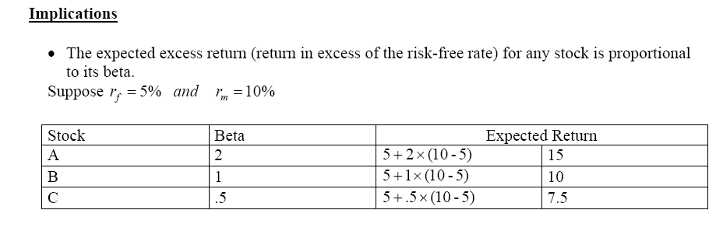
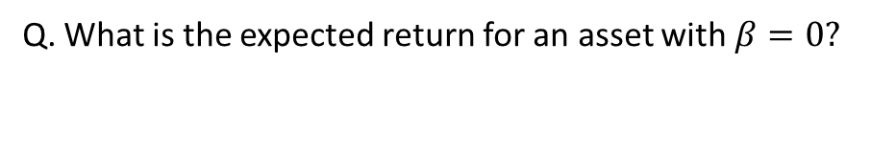
Q. What is the expected return for an asset with $β=0?$

Slide 4
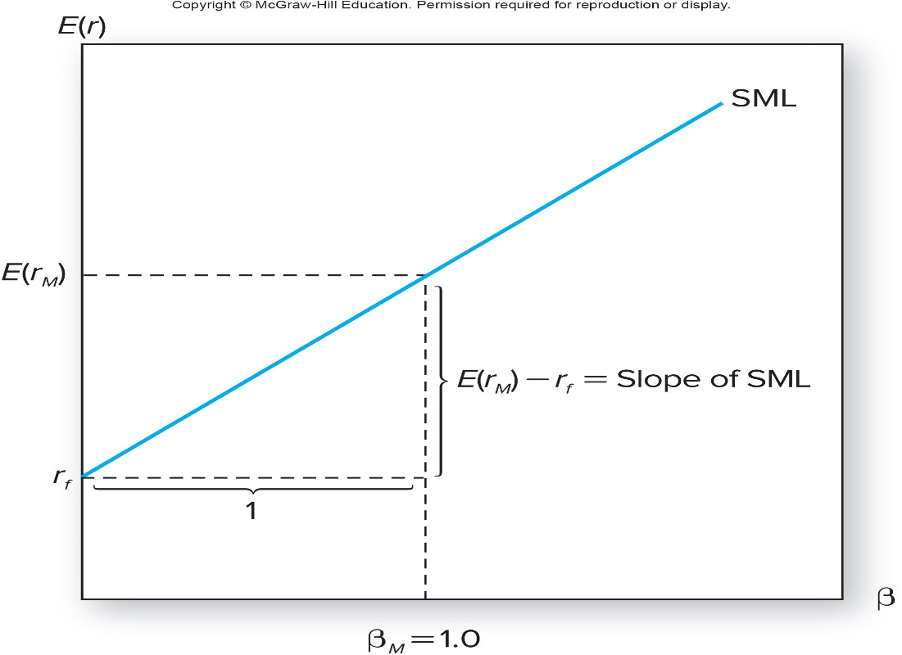
Security Market Line (SML)
The security market line characterizes the relation between expected returns and beta.

Slide 5
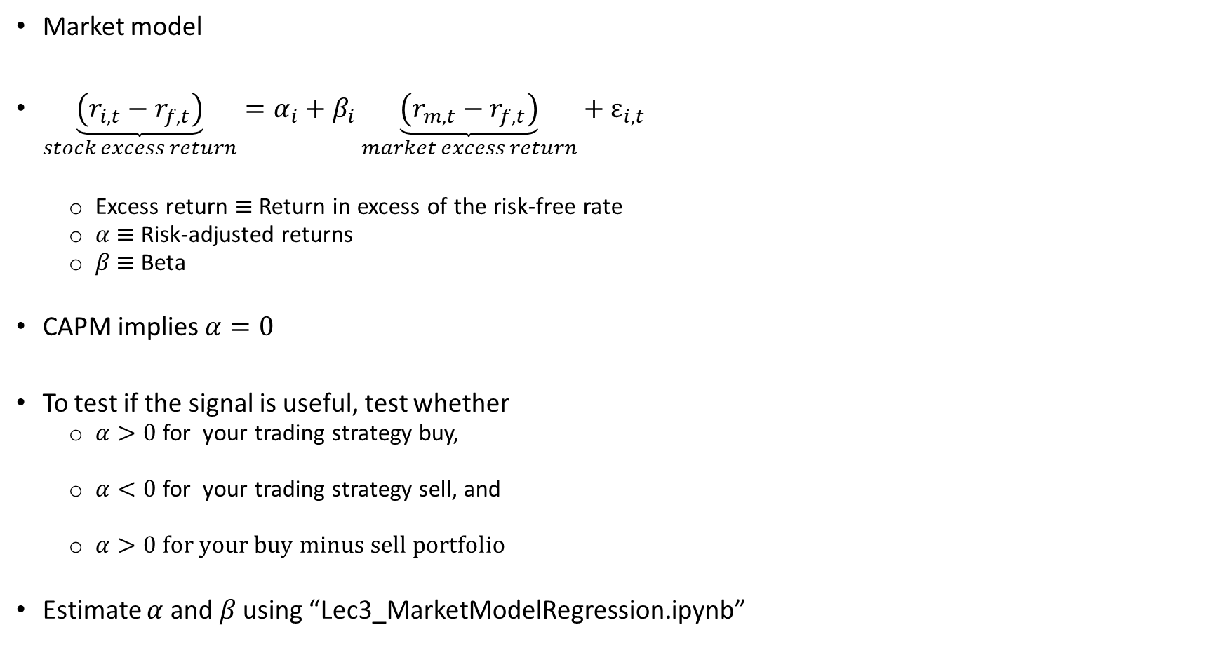
Risk-adjusted performance in back tests
Market model
$\underset{stock excess return}{\underbrace{\left(r_{i,t}−r_{f,t}\right)}}=α_{i}+β_{i}\underset{market excess return}{\underbrace{\left(r_{m,t}−r_{f,t}\right)}}+ε_{i,t}$
Excess return $≡$Return in excess of the risk-free rate
$α$ $≡$ Risk-adjusted returns
$β$ $≡$ Beta
CAPM implies $α=0$
To test if the signal is useful, test whether
$α>0$ for your trading strategy buy,
$α<0$ for your trading strategy sell, and
$α>0 for your buy minus sell portfolio$
Estimate $α$ and $β$ using “Lec3_MarketModelRegression.ipynb”

Slide 6

Stock and Portfolio betas
Q. $β_{i}≡$ beta of stock i. You form a portfolio with $N$ stocks and the weights in each stock is $w_{i}.$ What is the portfolio beta $\left(β_{p}\right)$?
$$β_{p}=\sum_{i=1}^{N}{{w_{i}×β}_{i}}$$
What is the beta of a market-neutral portfolio?

Slide 7
Market Neutral Portfolio
Vanguard Market Neutral Inv (VMNFX): https://advisors.vanguard.com/assets/corp/fund_communications/pdf_publish/us-products/fact-sheet/F0634.pdf
Investment objective: Vanguard Market Neutral Fund seeks to provide long-term capital appreciation while limiting exposure to general stock market risk.
Investment strategy: The fund seeks to meet its investment objective by purchasing securities that its advisor considers undervalued and selling short securities considered overvalued.
Q. What is short sale of a stock?

Slide 8
Short Sale: Step-by-Step
Time 0: Open short position
At time 0, a broker’s client [C] places an order for a short sale of ABC stock, trading at $100
Broker borrows shares on C’s behalf, and sells the for $100
The proceeds of $100 is kept as a collateral by the broker
Because the $100 belongs to C, the broker pays them an interest called short rebate.
If C is an institutional investors, the short rebate for a typical stock is Fed Fund Rate minus 25-50 basis points. The rebate could vary for hard-to-borrow stocks
Retail investors do not earn short rebate.

Slide 9
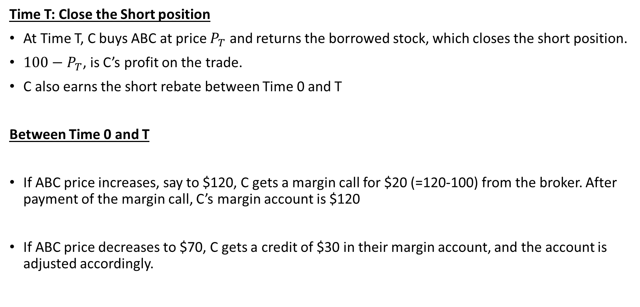
Short Sale: Step-by-Step
Time T: Close the Short position
At Time T, C buys ABC at price $P_{T}$ and returns the borrowed stock, which closes the short position.
${100−P}_{T}$, is C’s profit on the trade.
C also earns the short rebate between Time 0 and T
Between Time 0 and T
If ABC price increases, say to $120, C gets a margin call for $20 (=120-100) from the broker. After payment of the margin call, C’s margin account is $120
If ABC price decreases to $70, C gets a credit of $30 in their margin account, and the account is adjusted accordingly.

Slide 10
VMNFX Performance
Did the fund beat its benchmark?
What is the benchmark return?

Slide 11
Long/Short Funds
Suppose the riskfree rate is 2% and expected market return is 8%.
You have identified the following portfolios of undervalued and overvalued stocks and their betas:
What are the CAPM expected returns on these two portfolios?
You are managing a market-neutral long-short fund. Your long position is $100m of portfolio A. What should be your short position in portfolio B?
What are the portfolio weights for the long and short positions and the margin account?
Why would you short portfolio B when its expected return is positive?
Portfolio | Expected Return | Beta | CAPM expected return
A | 10 | 1.0
B | 3 | 1.2

Slide 12
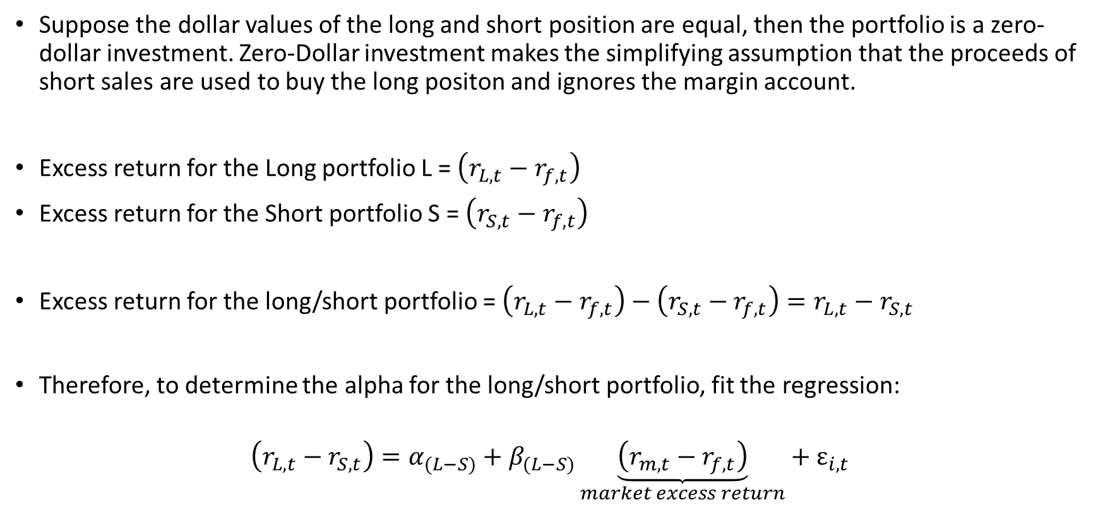
Market Model for Long/Short Portfolios
Suppose the dollar values of the long and short position are equal, then the portfolio is a zero-dollar investment. Zero-Dollar investment makes the simplifying assumption that the proceeds of short sales are used to buy the long positon and ignores the margin account.
Excess return for the Long portfolio L = $\left(r_{L,t}−r_{f,t}\right)$
Excess return for the Short portfolio S = $\left(r_{S,t}−r_{f,t}\right)$
Excess return for the long/short portfolio = $\left(r_{L,t}−r_{f,t}\right)−\left(r_{S,t}−r_{f,t}\right)=r_{L,t}−r_{S,t}$
Therefore, to determine the alpha for the long/short portfolio, fit the regression:
$$\left(r_{L,t}−r_{S,t}\right)=α_{(L−S)}+β_{(L−S)}\underset{market excess return}{\underbrace{\left(r_{m,t}−r_{f,t}\right)}}+ε_{i,t}$$

Slide 13
Key Takeaways
Risk and return are directly related.
CAPM provides a framework to estimate expected returns.
Short Sales and Market-Neutral Portfolios
Risk-adjusted metrics are essential for performance evaluation.

